Slide 1

Capstone project
Vicky kumar

Slide 2
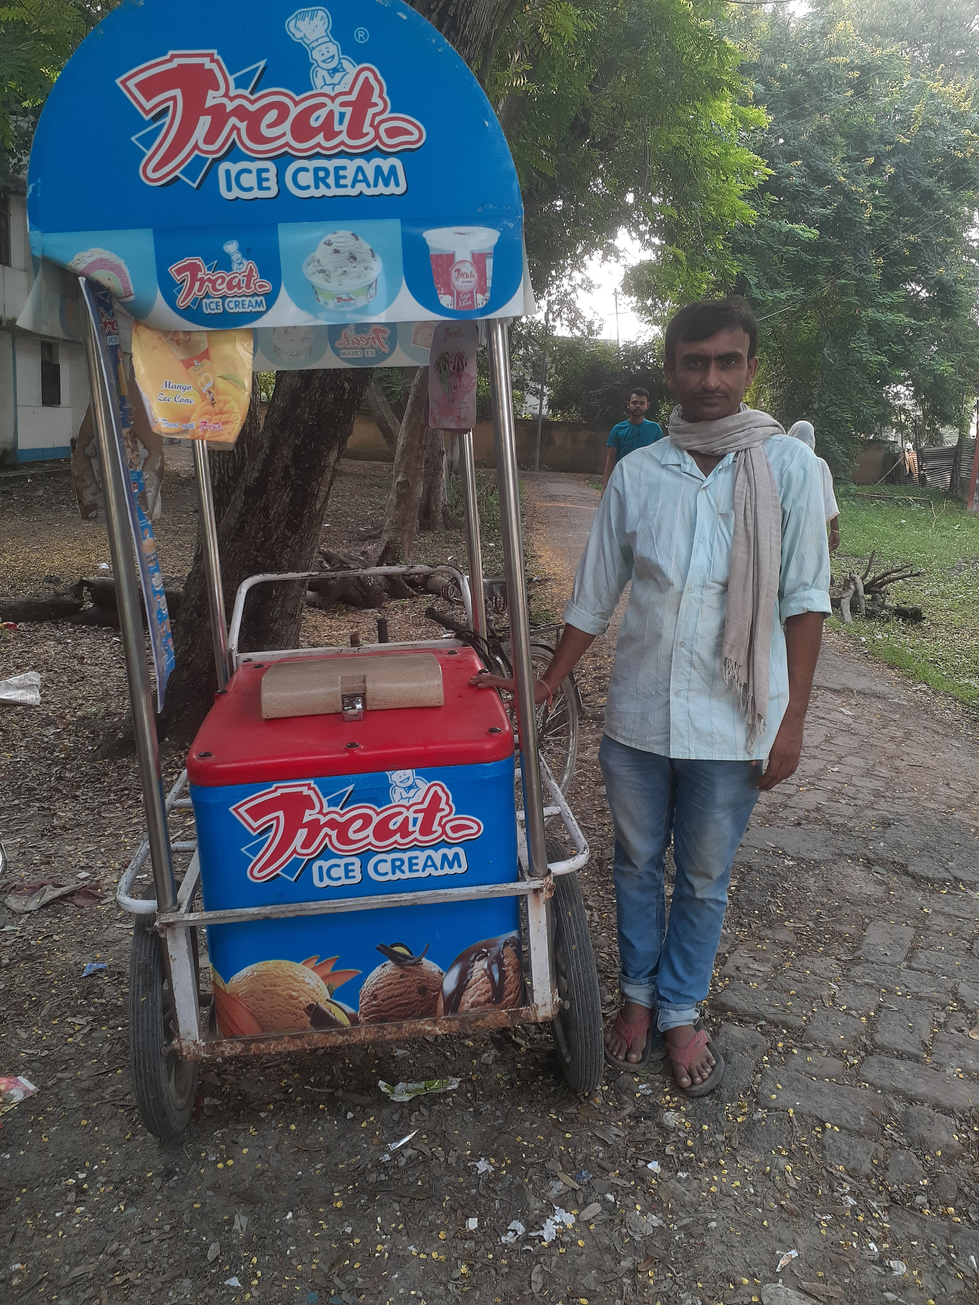
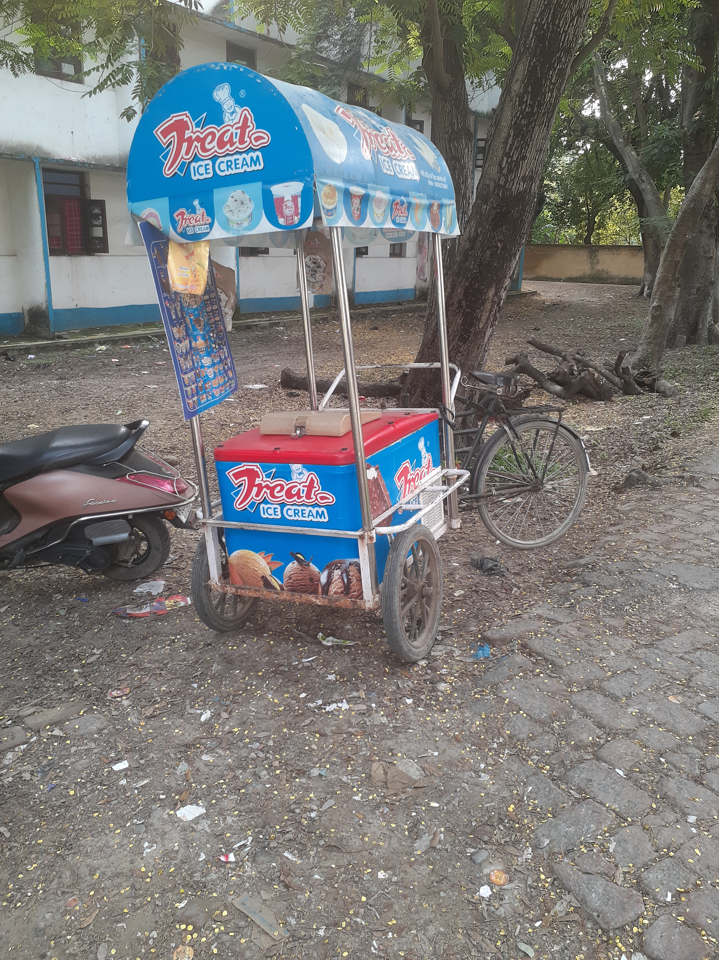
About the business and data collection
Sunil Yadav is a local street vendor selling ice cream of various flavour.
He has been doing his business from at least 5 years and the stall is located at Muzaffarpur, Bihar.
The data was collected over a period of 1 month, from 19 February to 18 March by visiting his stall and asking questions about their business.
The analysis is done using MS Excel.

Slide 3
Revenue/ Gross profit Throughout WEEKS
The stall generates revenue of a total of ₹ 1,66,090 in the month.
Week 2 generates the most revenue, which is ₹ 44,030 and week 1 generates the least revenue, which is ₹ 38,975.
The stall generates a gross profit in the month is ₹ 28,733.
Week 2 generates the most profit, which is ₹ 7,722 and week 4 generates the least profit, which is ₹ 6,637.

Slide 4
Flavour analysis weekly
Chocolate and chocobar are the most popular, and American nuts have the least popular flavour among customers.
Sales of matka kulfi are nearly half than the chocolate.
Matka kulfi generates more revenue.
Instead of popular flavour(chocolate, chocobar) it doesn’t generate the highest revenue among all flavour

Slide 5
Revenue/ Gross profit on daily basis
The highest revenue and gross profit generate in a month on 11-mar that is Sunday and the trend is that Saturday and Sunday is the day that generate most revenue.
On the first day of the week, revenue and gross profit both declined by almost half compared to Sunday.

Slide 6
Recommendation
To increase revenue, the vendor should focus on Matka kulfi flavour because of high margin. Keeping schemes such as buy 5 Matka kulfi flavour and get a Chocolate or Chocobar flavour free.
To increase demand, the vendor should keep the margin low on less popular flavours. Due to this, more customers will attract to his stall.
Installing a QR code scanner at the stall would undoubtedly raise sales.
To attract children, the vendor should include cheap plastic toys with those flavour that are low in sales.
To increase customer attraction, the vendor should install a dustbin at the stall.

Slide 7


Thank you
Name – vicky kumar
Roll – 21f1005331

